Slide 1
April 28, 2016 Training
Green Stormwater Infrastructure (GSI) Typical Details
Low Impact Development (LID) Standard Details
Additional NEW City of Tacoma Std Details
Part of City of Tacoma Right-of-Way Design Manual webpage (www.cityoftacoma.org/designmanual)
City of Tacoma Right-of-Way Design Manual (DM)
LID Standard Plans and GSI Typical Details
City of Tacoma Specifications
On www.govMe.com & www.cityoftacoma.org/designmanual

Slide 2
Green Stormwater Infrastructure Typical Details
Green Stormwater Infrastructure (GSI) – a set of distributed stormwater best management practices (BMPs) that seek to mimic natural systems and deliver multiple community benefits in addition to stormwater management. Green stormwater infrastructure can be used at a wide range of landscape scales in place of more traditional stormwater control elements to support the principles of Low Impact Development.
GSI Typical Details: (non-engineered) mostly for onsite stormwater management (SWMM Minimum Requirement #5 and retrofit)
Include material Specifications (WSDOT / City of Tacoma Specification / SWMM)
Adopted and Effective January 7, 2016
In SWMM & on www.govMe.com or www.cityoftacoma.org/designmanual

Slide 5
SWMM Vol. 3 - BMP L602 Downspout Infiltration Trench and Drywells
Sizing Table based on USDA Soil Type
Soil Report Requirements - Refer to Volume 3 Appendix B
Must use standard section and follow all limitations of the BMP
(trench length, trench spacing, pipe type and size, etc.)

Slide 7
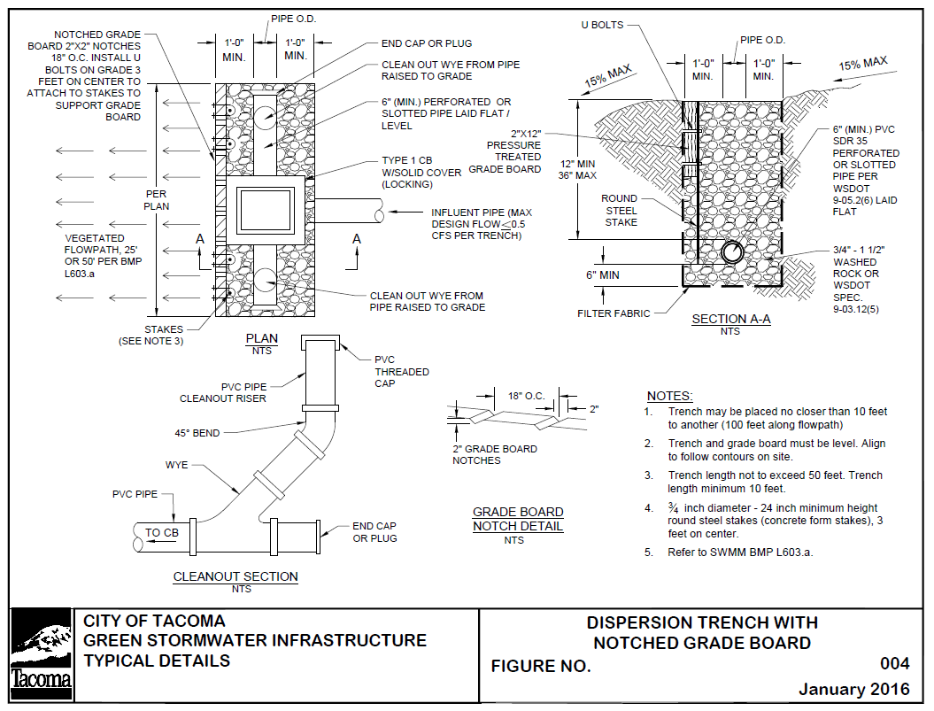

Slide 10
SWMM Vol. 3 - BMP L603 Downspout Dispersion
Sizing included in BMP & on detail
No Soil Testing Requirements
Must use standard sections and follow all limitations of the BMP
(trench length, trench spacing, pipe type and size)
Vegetated Flow path required (25’ or 50’ length see BMP)
Vegetated Flow Path must be established vegetation.
For Flow Credit - vegetated flow path must be undisturbed native or lawn/landscaped with soil amendments per BMP L613 (Std. Plan GSI-01a-d)

Slide 12
SWMM Vol. 3 - BMP L604 Perforated Stubout
Sizing included in BMP and on detail
Soil Report per Volume 3 Appendix B
Must use standard section and follow all limitations of the BMP
(length, materials, pipe type and size)
Amended soil per BMP L613 (Std. Plan GSI-01a-d) required above

Slide 15
SWMM Vol. 3 - BMP L611 and BMP L612 Flow Dispersion
Sizing included in BMP and on detail
No Soil Report Required
Must use standard section and follow all limitations of the BMP
Minimum 10’ long vegetated flowpath required (additional length for contributing area greater than 20’ in width)
25’ or 50’ vegetated flowpath length required for Concentrated Flow Dispersion
Vegetated flowpath must be established vegetation.
For Flow Credit - Vegetated Flow must be undisturbed native or lawn/landscaped with soil amendments per BMPL613 (Std. Plan GSI-01a-d)

Slide 16
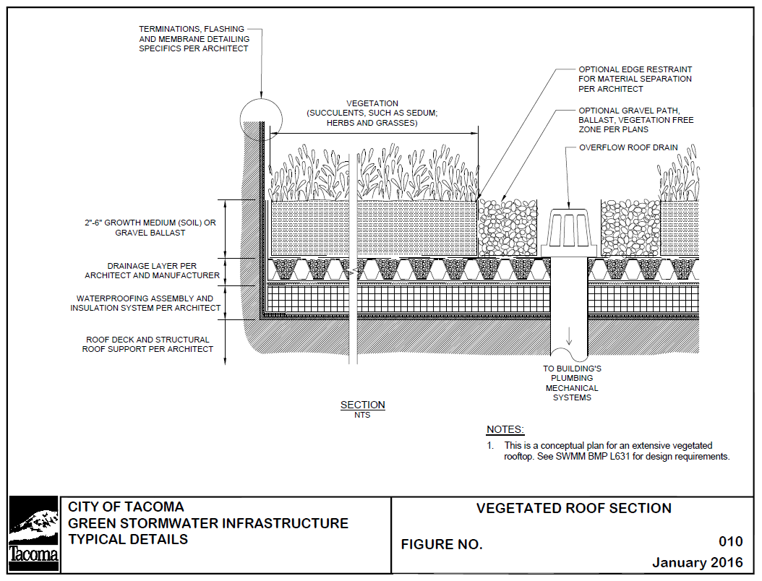

Slide 17
SWMM Vol. 6 - BMP L631 Vegetated Roof
LID Technical Guidance contains design criteria
TMC 2.02.160 allows for vegetated roofs
Structural information will be required as with any roof. Information on the vegetated roofing section and materials will be required.

Slide 18
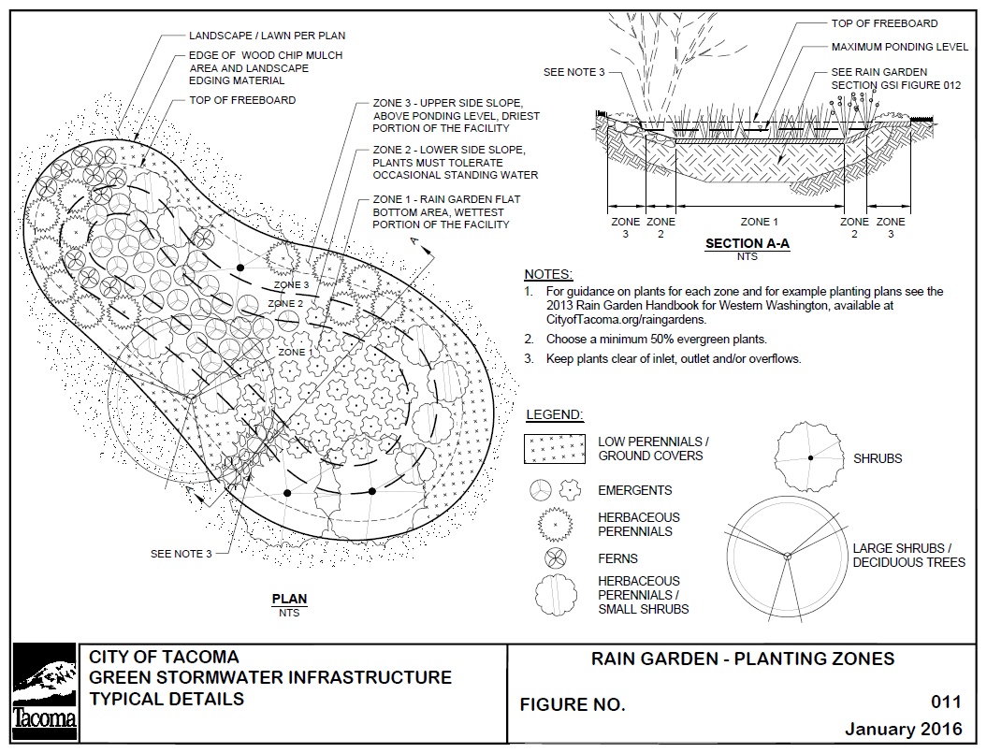

Slide 19
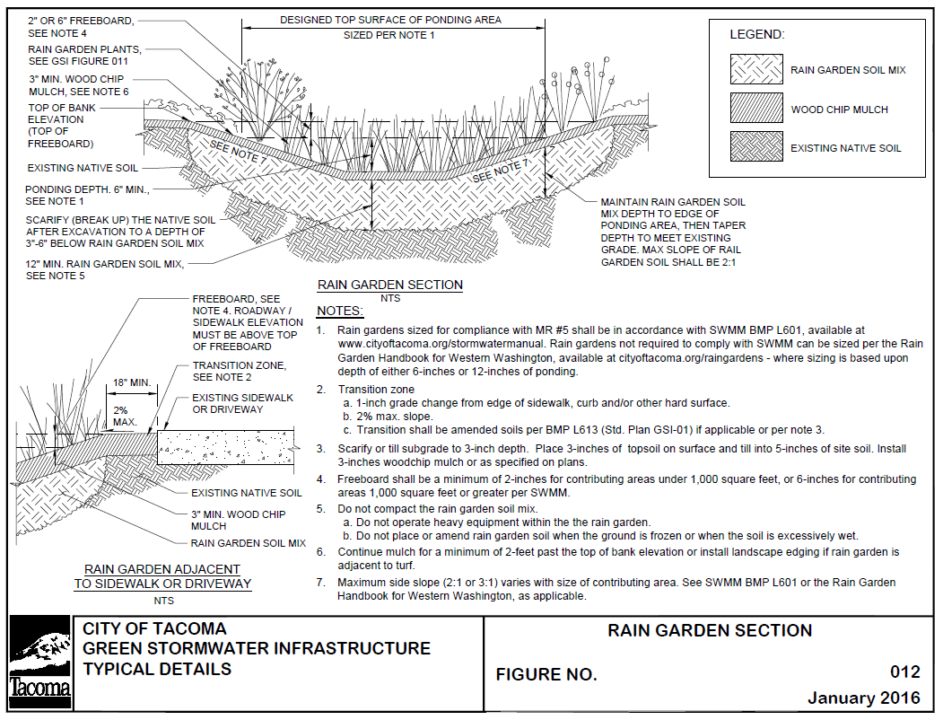

Slide 20
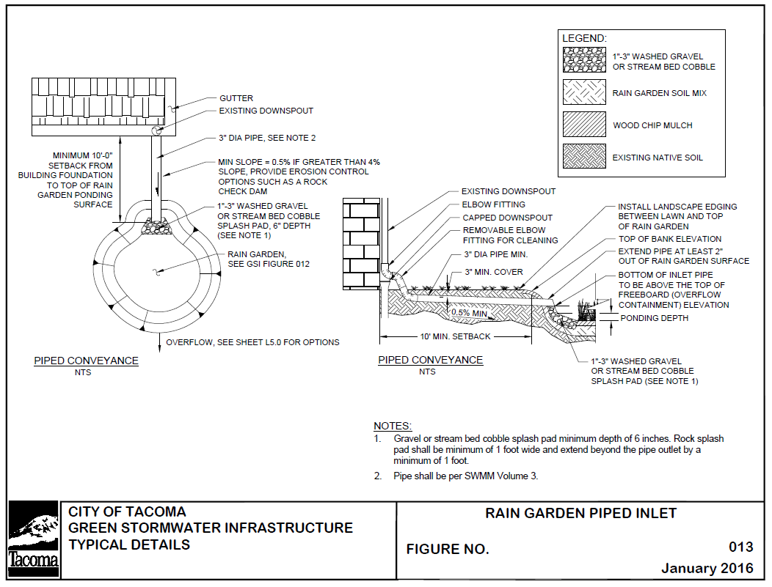

Slide 23
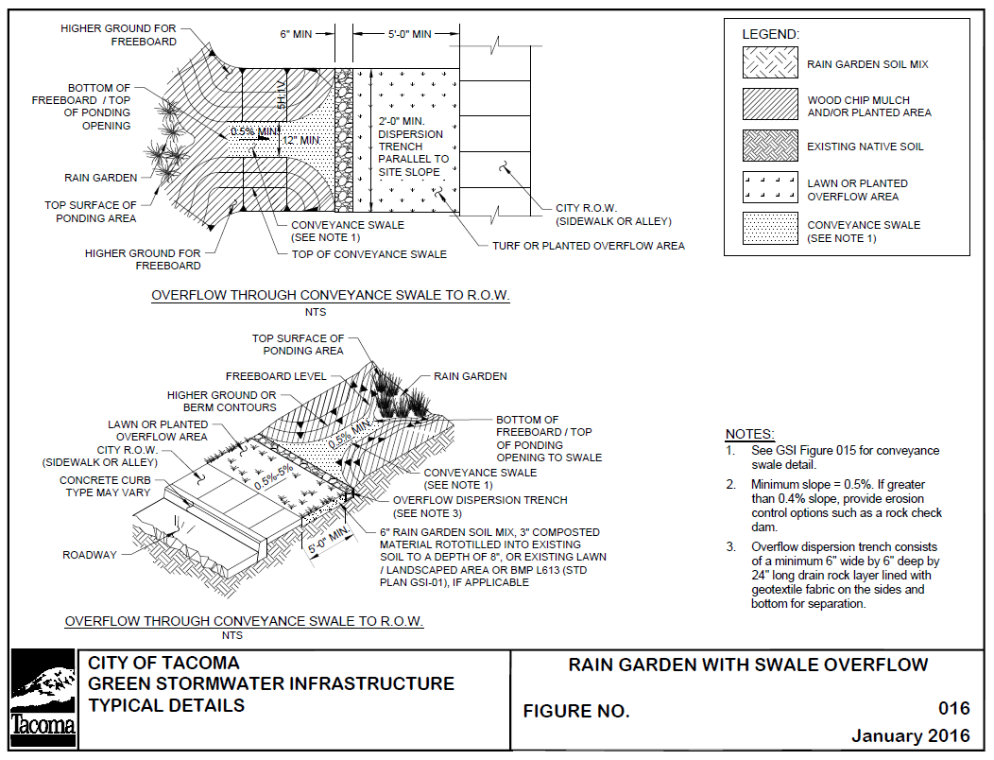

Slide 24
SWMM Vol. 6 - BMP L601 Rain Gardens
Sizing Table based on Contributing Area
Soil Report Required - See Volume 3 Appendix B
Must use standard section and follow all limitations of the BMP
Ponding depth 12 inches for BMP L601 – retrofits may use 6” or 12”
Separate details available for:
Section (GSI-012)
Inlet (GSI-013, GSI-014)
Overflow (GSI-015, GSI-016)
Planting Plan (GSI-011) – can be redlined for site
Overflow can not damage downstream properties
For Bioretention Refer to:
Volume 6 - BMP L630 Bioretention and Standard Plans GSI -03 and GSI-06 series

Slide 25
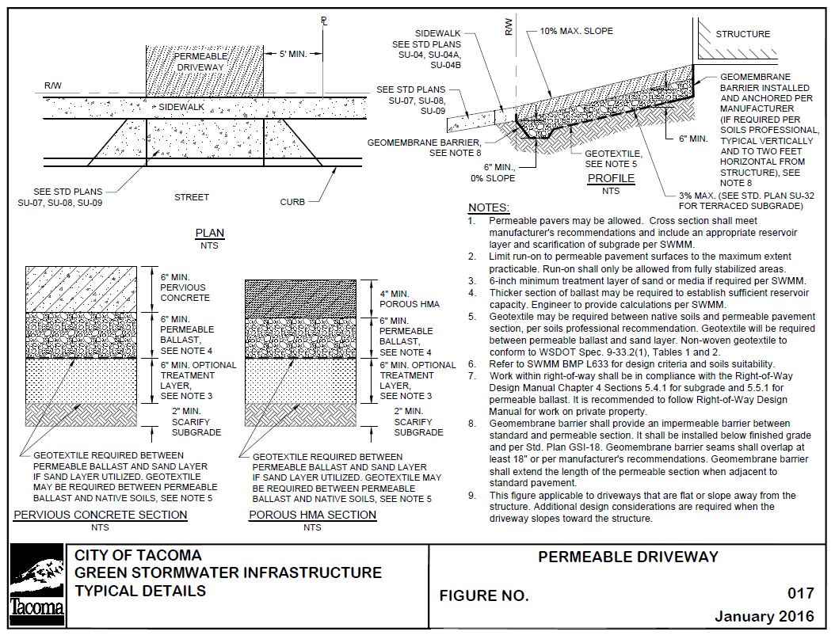

Slide 26
SWMM Vol. 6 - BMP L633 Permeable Pavement
Soils Report Required - See to Volume 3 Appendix B
Minimum reservoir section per typical detail
WWHM modeling not required for SFR or Duplex unless special circumstances (larger than typical driveway size, run-on directed to permeable pavement, etc.)
Additional considerations will be required from applicant for driveways that slope towards the structure
Must use standard section and follow all limitations of the BMP
(section depths and materials)
Recommend Using APWA Standard Specification for Permeable Pavements and Soil Preparation http://www.wsdot.wa.gov/Partners/APWA/

Slide 27
Questions???

Slide 28
Low Impact Development Standard Plans Project
Green Stormwater Infrastructure and Low Impact Development facilities / Engineered facilities (typically)
Required for use in Right-of-Way unless approved otherwise by City of Tacoma / May be applicable to onsite (private property)
Located in various categories of the Standard Plans based on subject
New Category Green Stormwater Infrastructure
Part of City of Tacoma Right-of-Way Design Manual webpage
City of Tacoma Right-of-Way Design Manual
LID Standard Plans and GSI Typical Details
City of Tacoma Specifications
Standard Plans Adopted and Effective April 4, 2016
On www.govMe.com & www.cityoftacoma.org/designmanual

Slide 29
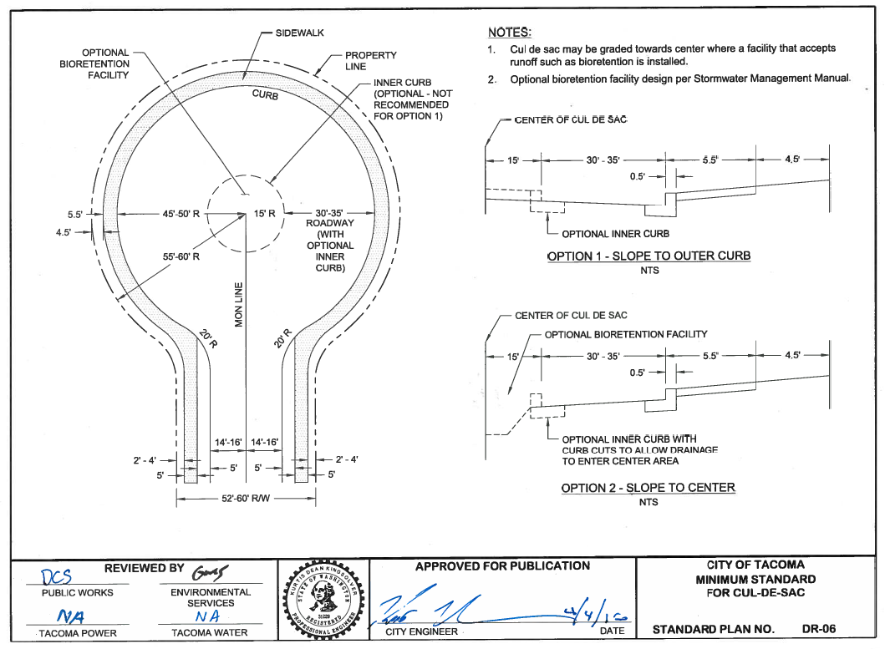

Slide 30
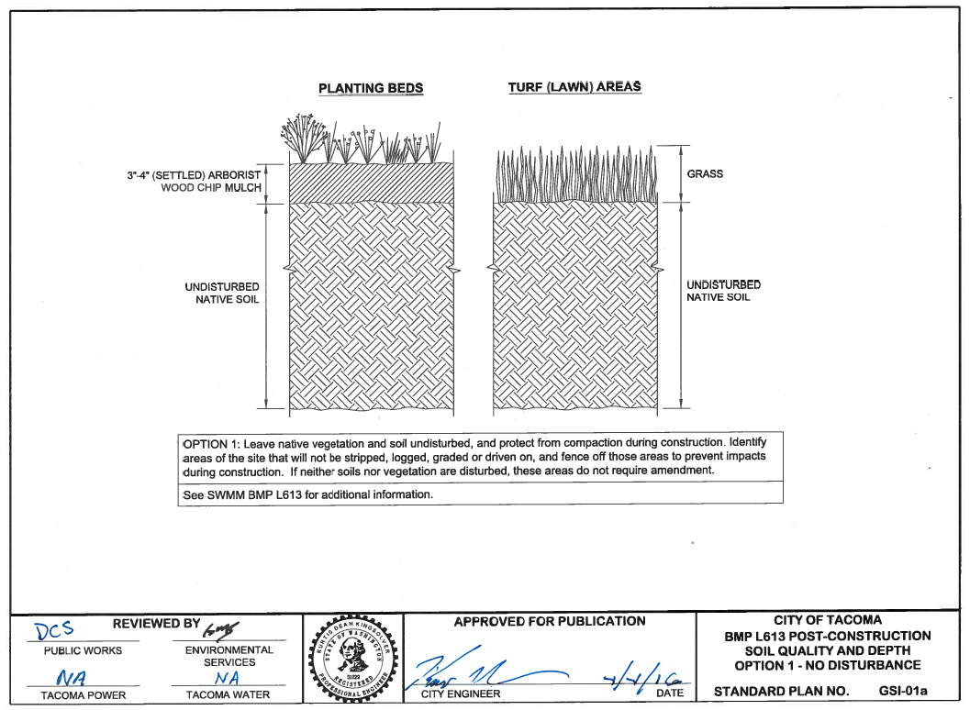

Slide 31
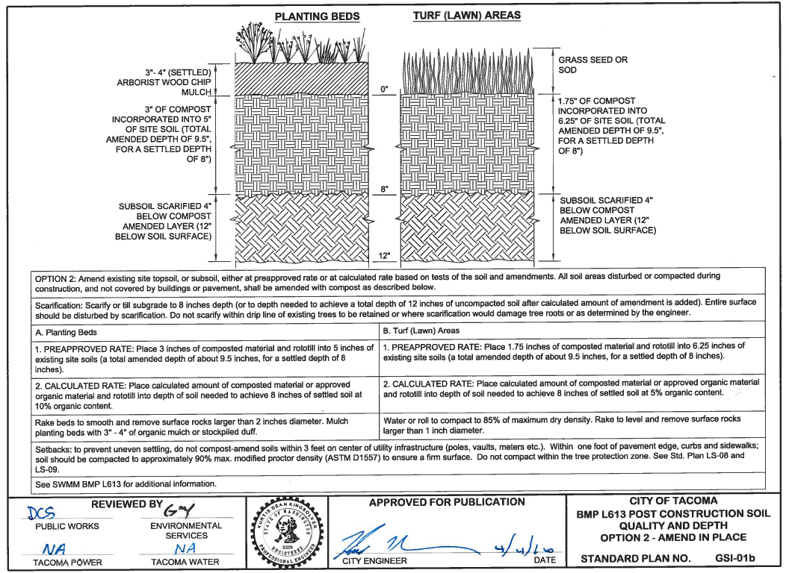

Slide 32
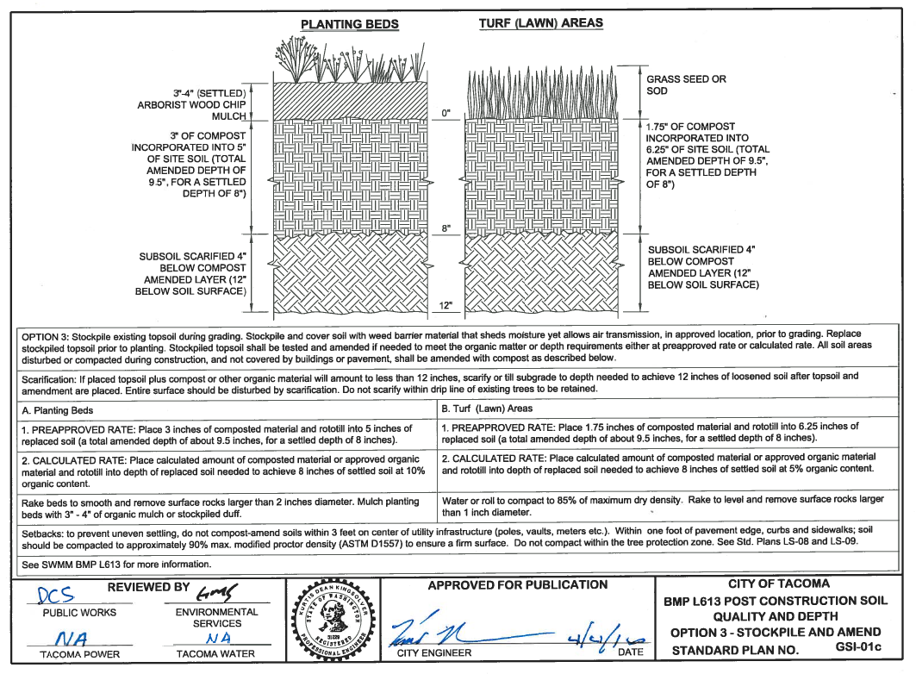

Slide 33
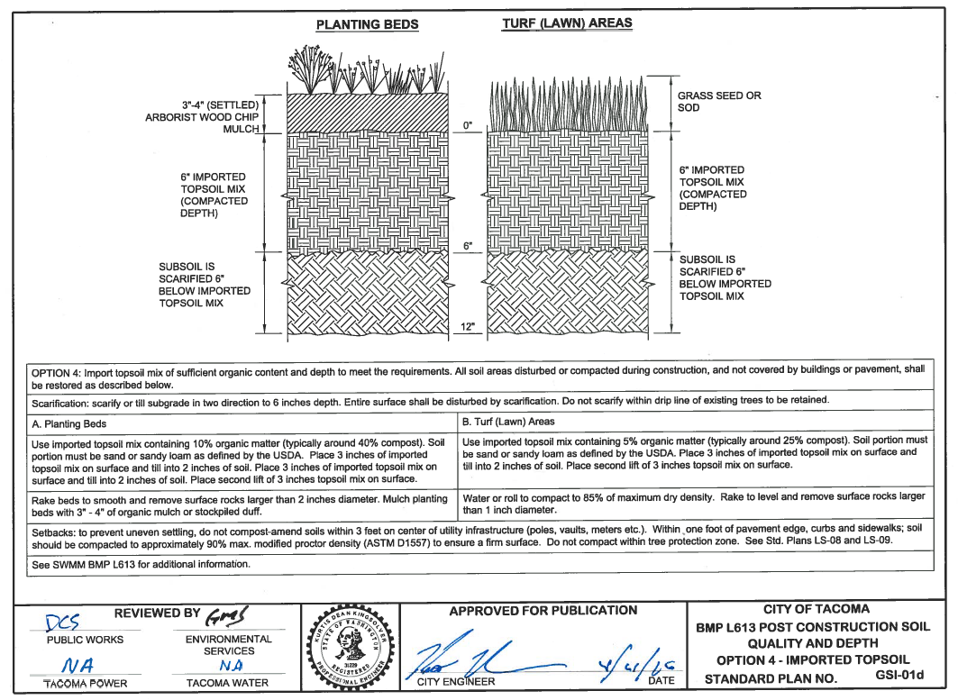

Slide 34
SWMM Vol. 3 - BMP L613 Post-Construction Soil Quality and Depth
Choose one option for each location as appropriate
This BMP will be required at most sites and for most projects – see SWMM
This is a requirement for SWMM - Minimum Requirement #5 and preferred for restoration of pervious areas within the Right-of-Way.

Slide 35
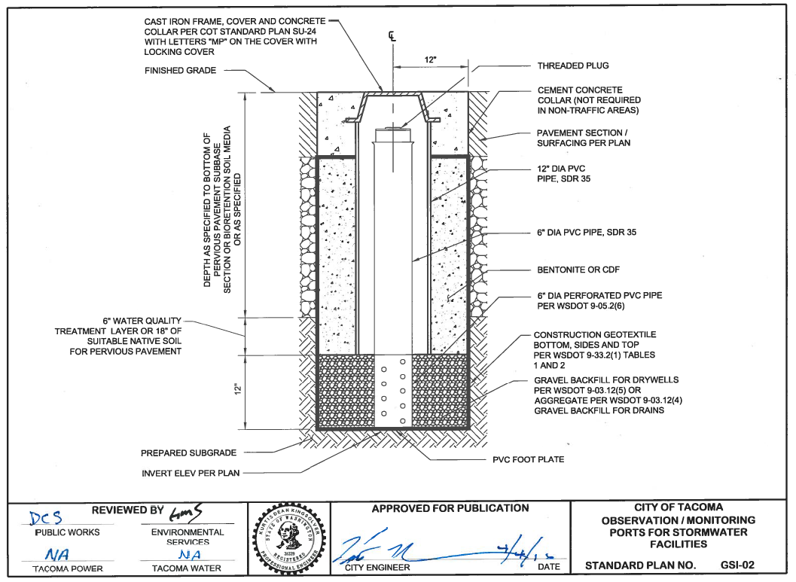

Slide 36
GSI-02 Observation / Monitoring Port for Stormwater Facilities
Typically used with an infiltrating bioretention facility or permeable pavement to assess water level beneath surface
For installations within the Right-of-Way contact Environmental Programs to determine number and location to install monitoring ports
Required in South Tacoma Groundwater Protection District for high-intensity sites that infiltrate – Refer to SWMM Volume 5 Appendix D

Slide 37
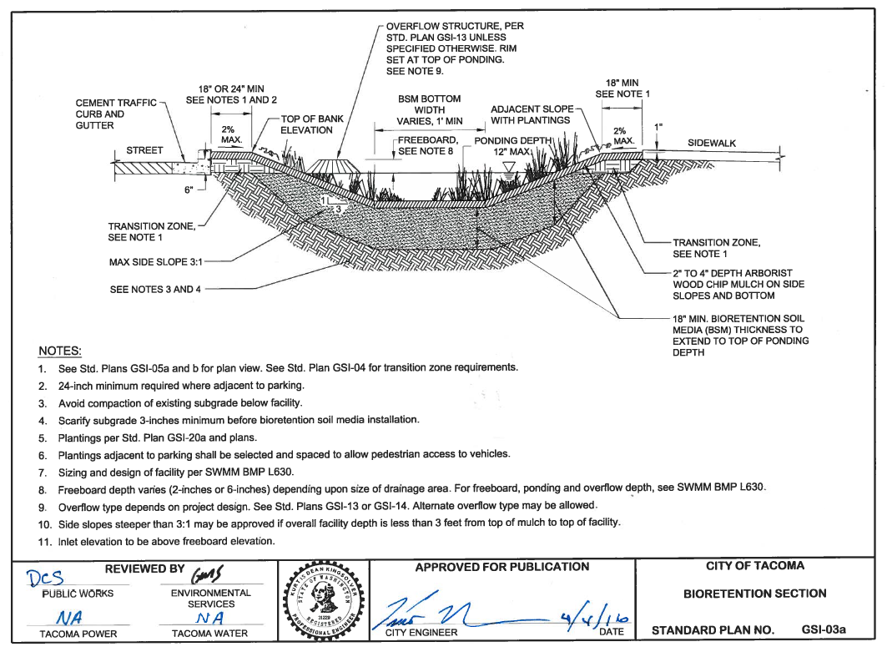

Slide 38
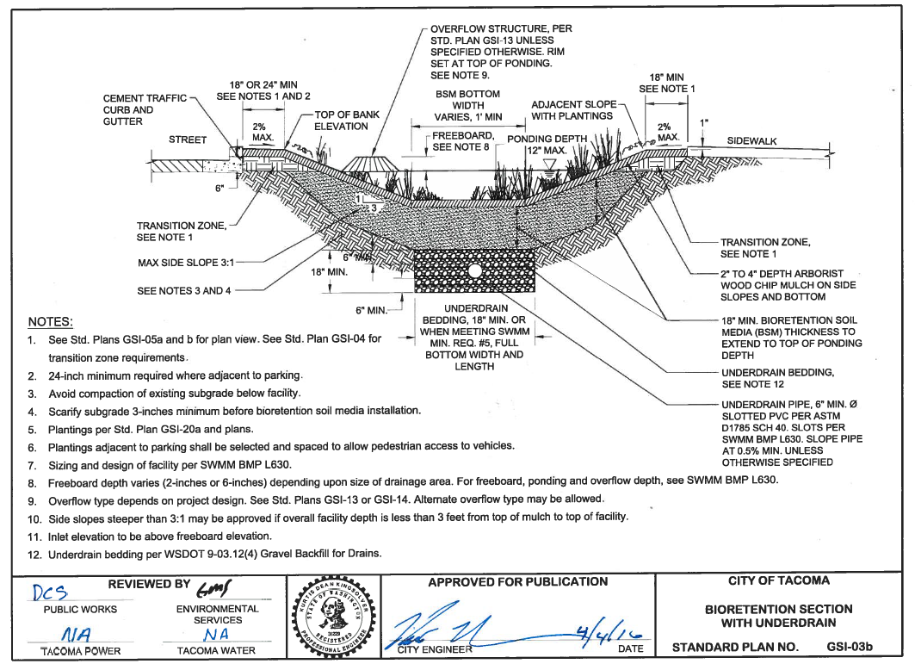

Slide 39
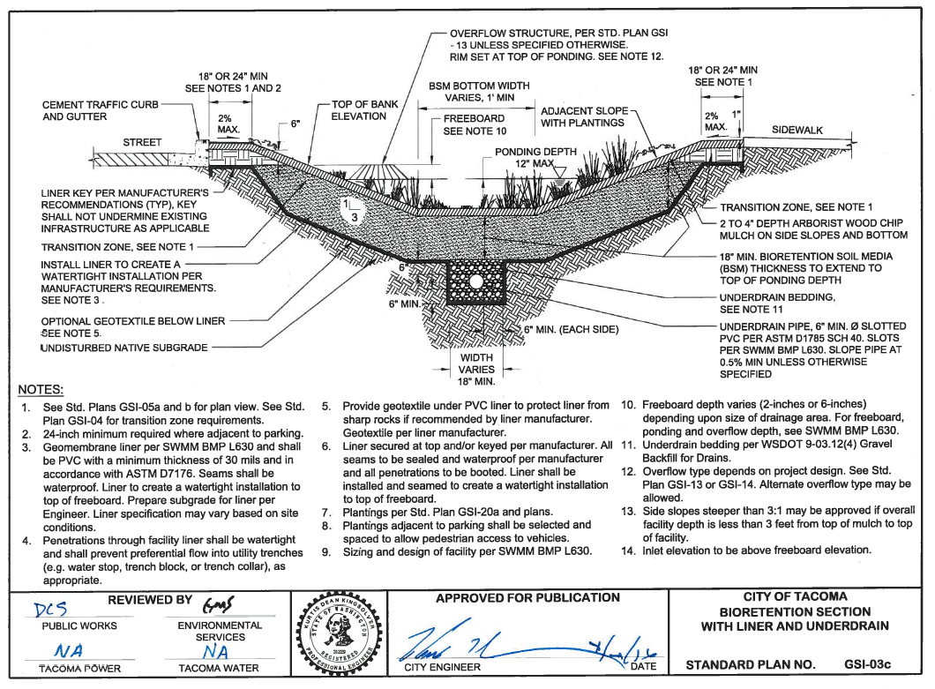

Slide 40
SWMM Vol. 6 BMP L630 - Bioretention
Refer to SWMM for sizing, design criteria and infeasibility criteria
Soil Report Requirements per Volume 3 Appendix B

Slide 41
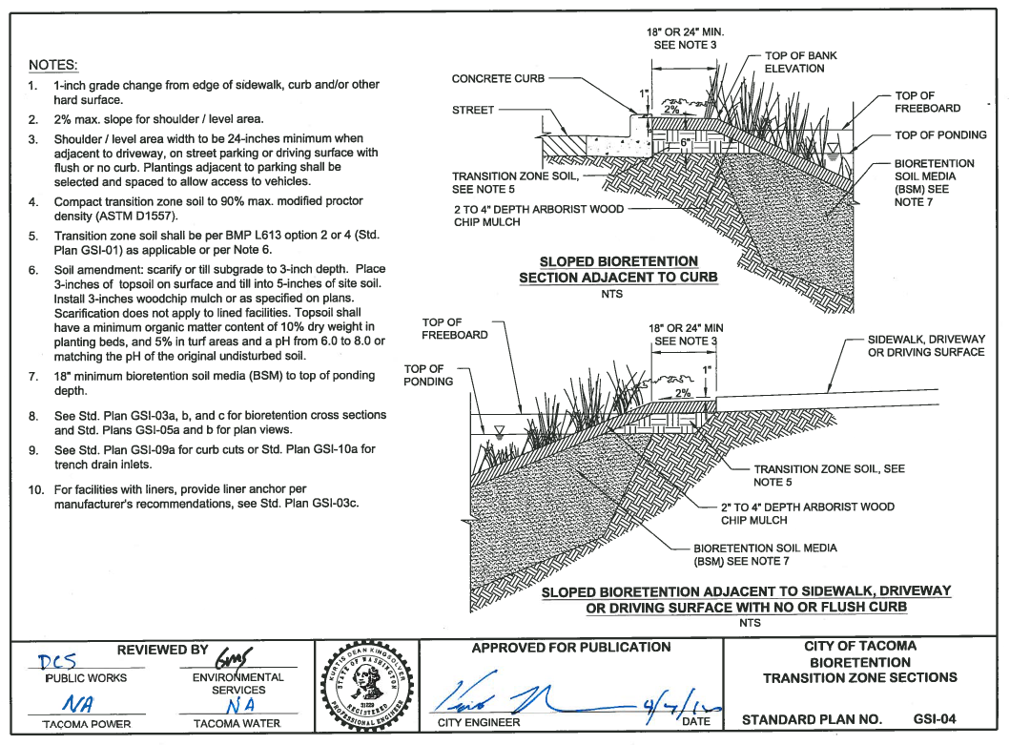

Slide 42
GSI-04 Bioretention Transition Zone Sections
Must adhere to this detail
These details developed for constructability and tie in with roadway requirements

Slide 43
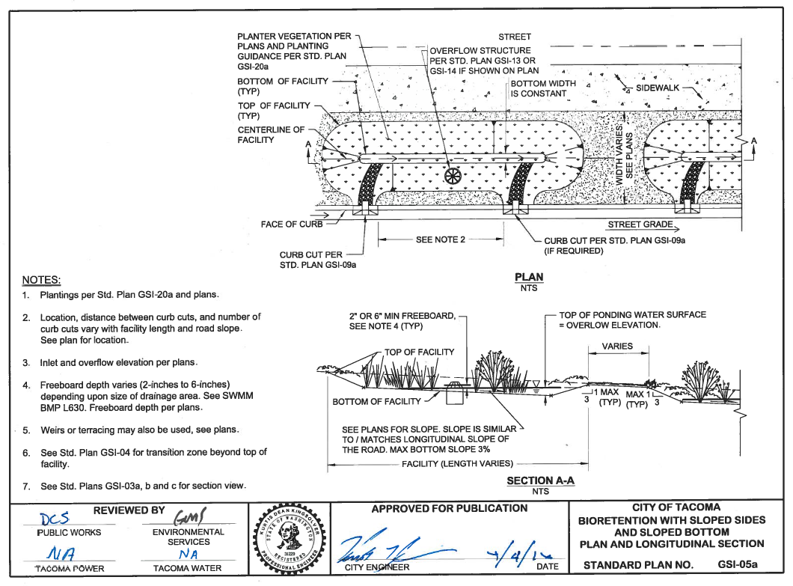

Slide 44
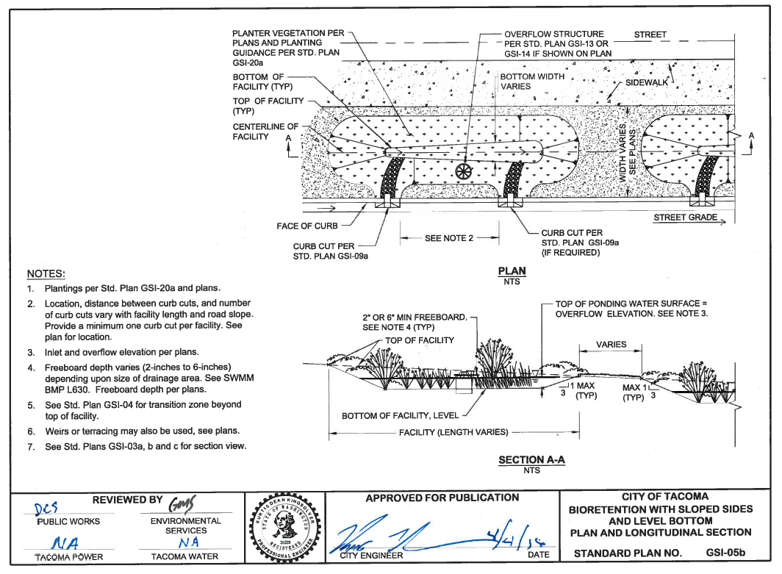

Slide 45
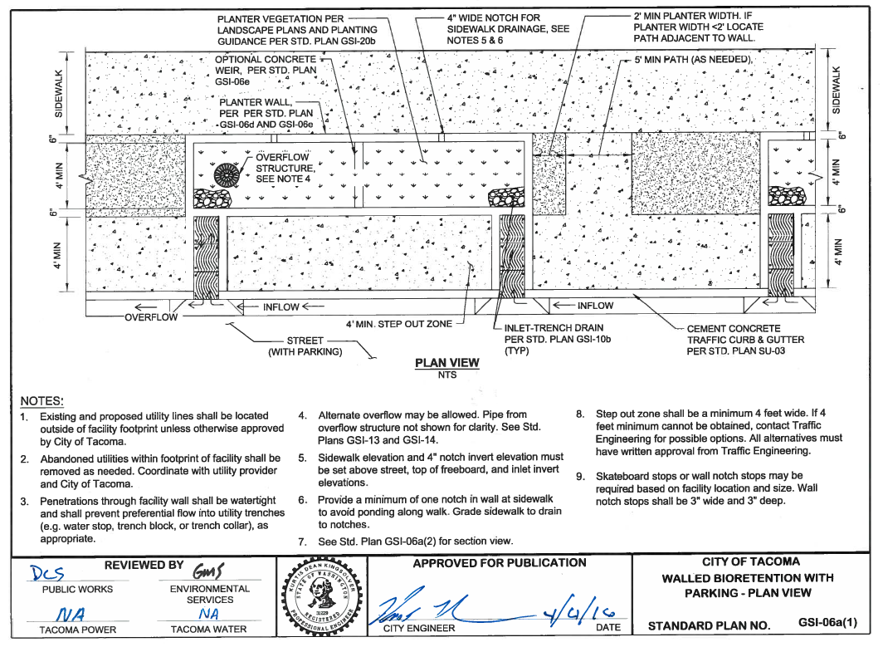

Slide 46
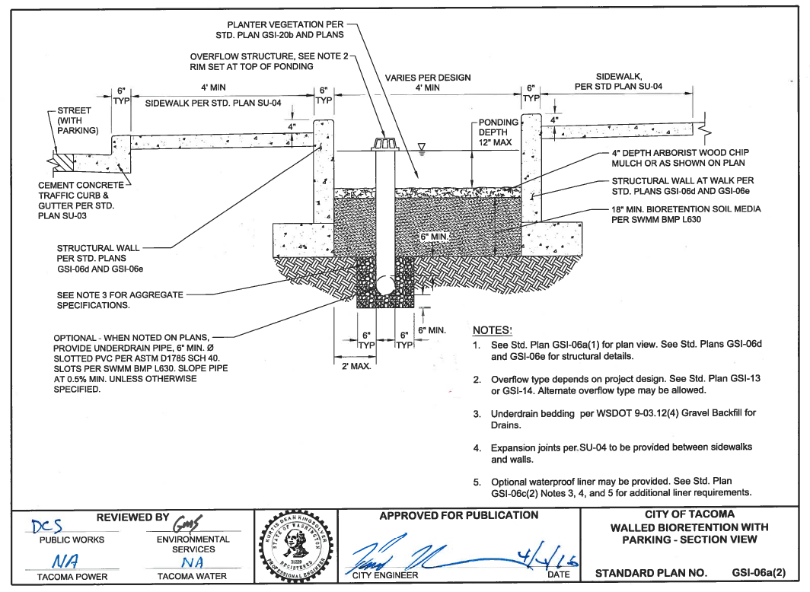

Slide 47
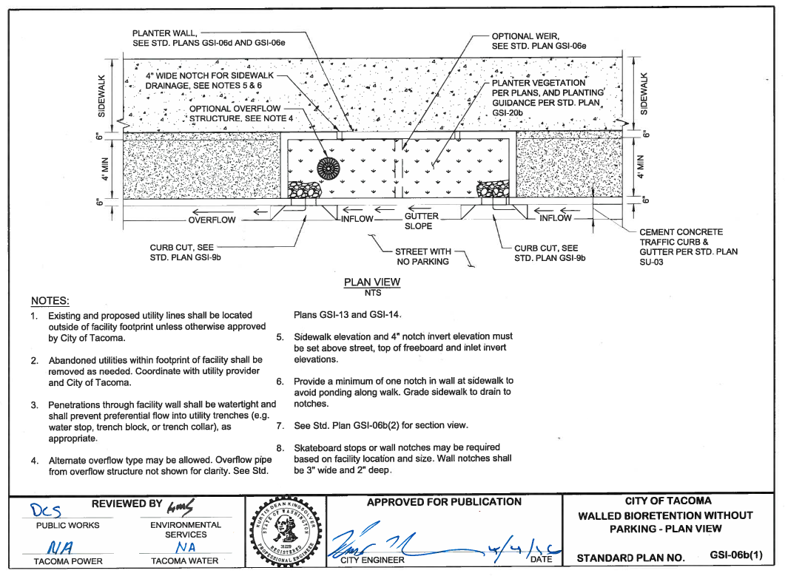

Slide 48
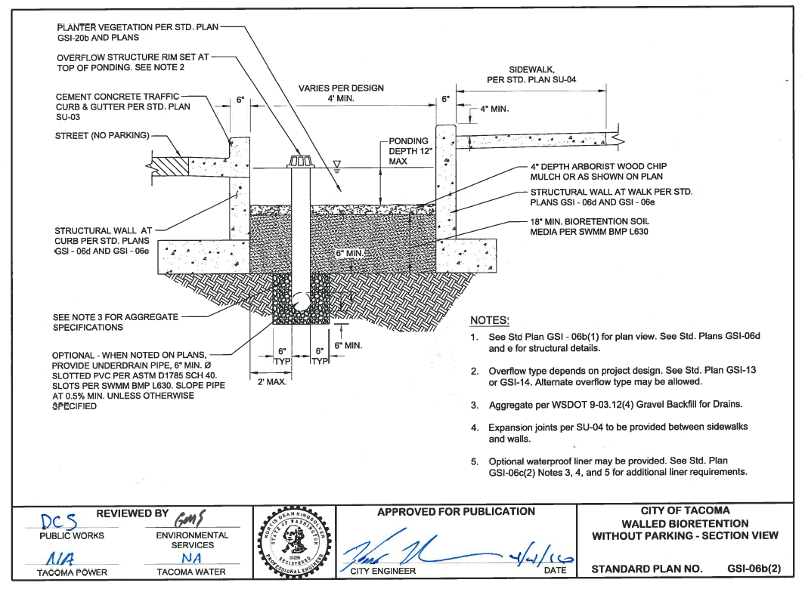

Slide 49
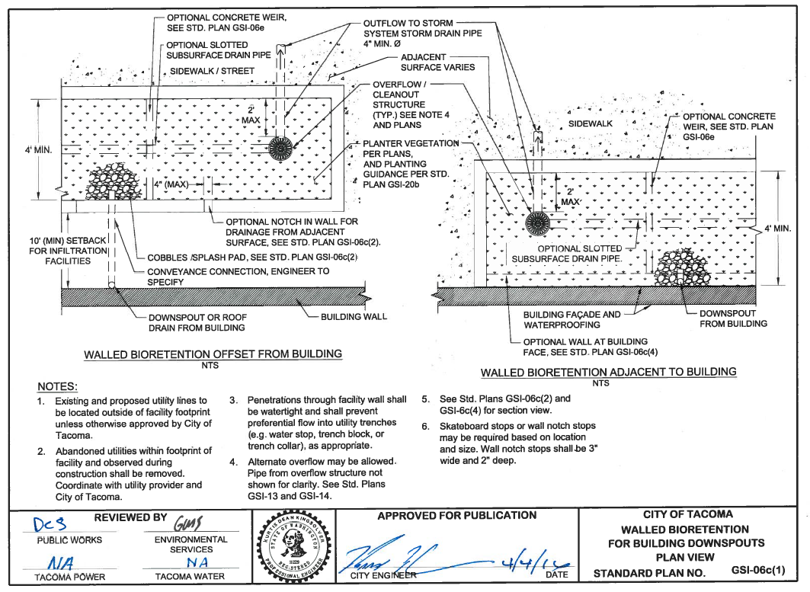

Slide 50
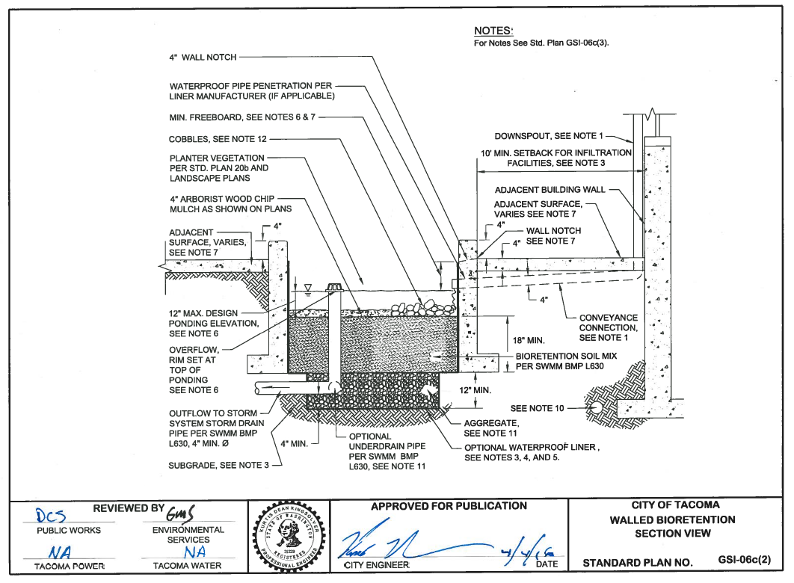

Slide 51
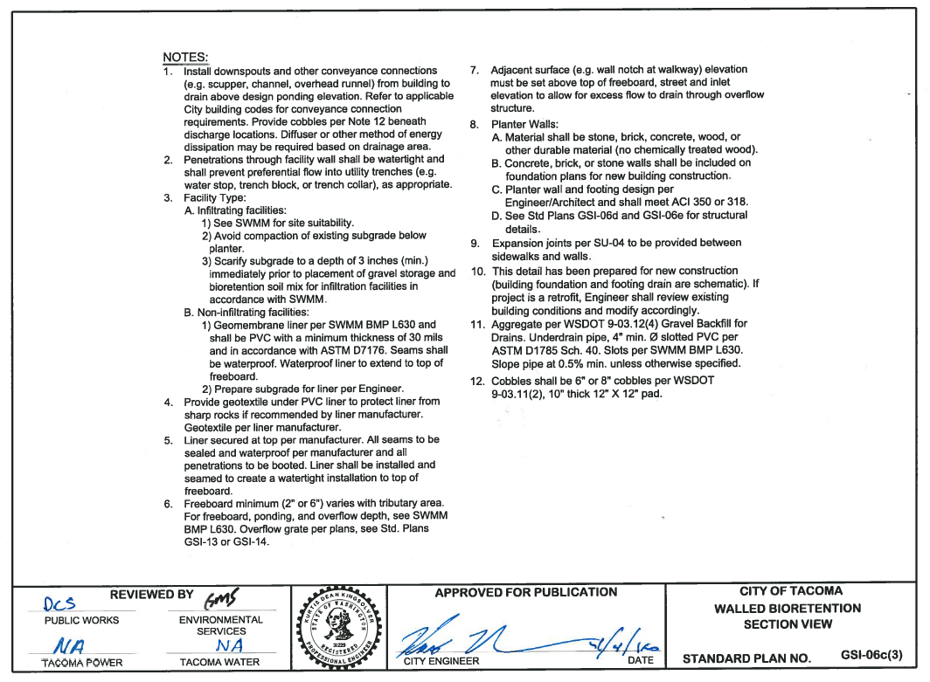

Slide 52
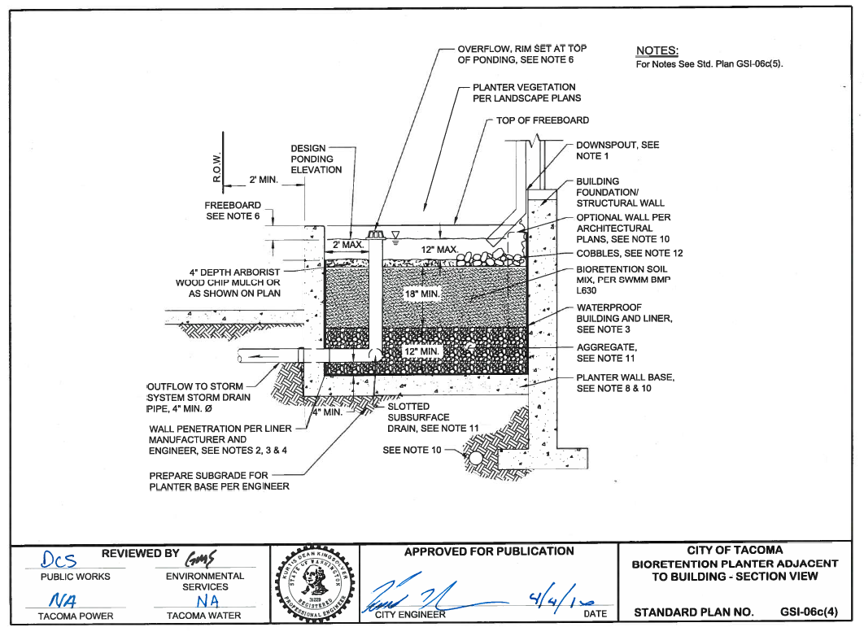

Slide 53
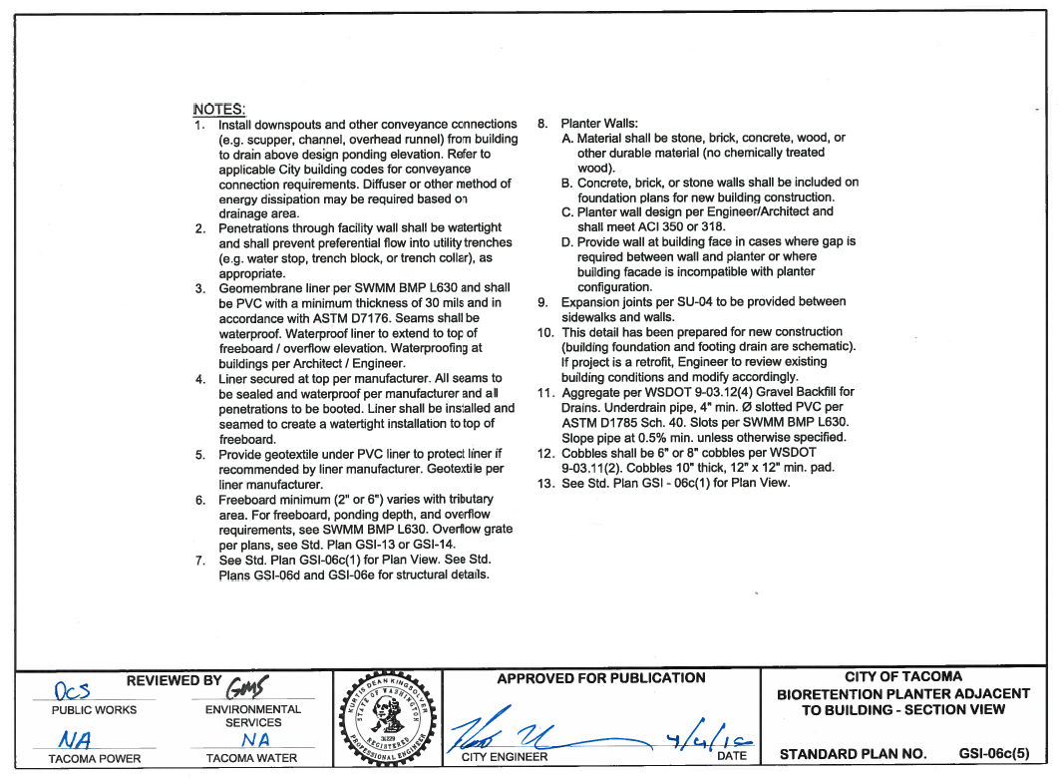

Slide 54
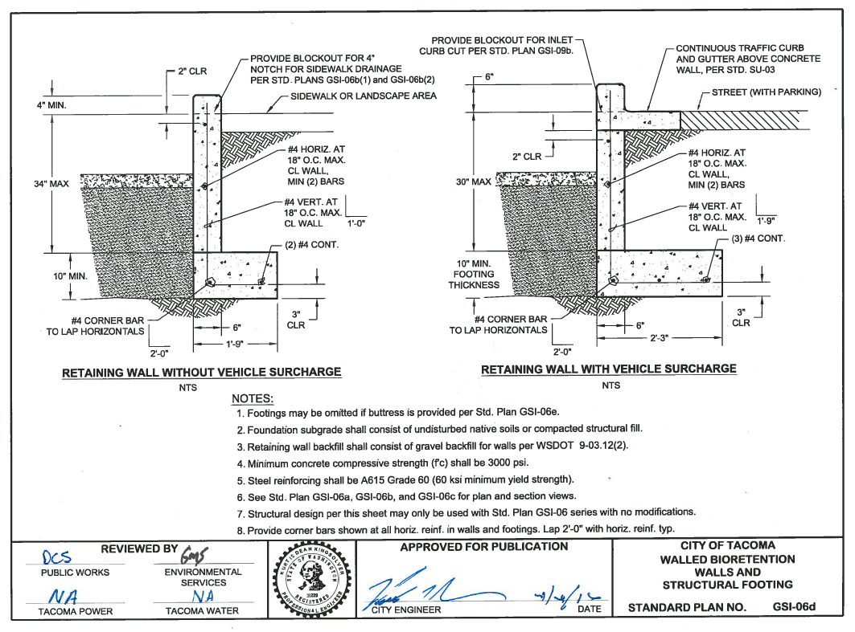

Slide 55
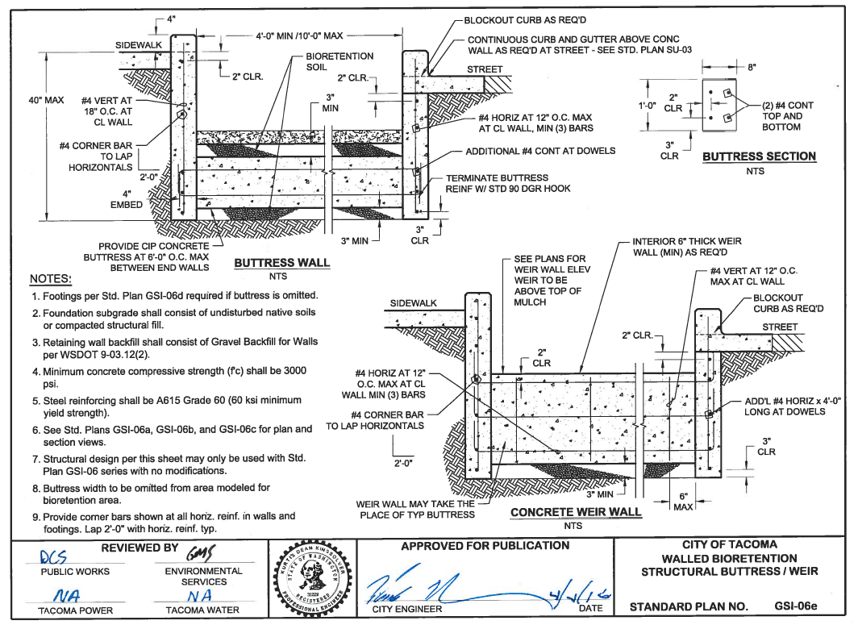

Slide 56
SWMM Vol. 6 BMP L630 - Bioretention
Refer to SWMM for sizing, design criteria and infeasibility criteria
Soil Report Requirements per Volume 3 Appendix B
Additional soils information may be required for structural review
Must use GSI-06 series exactly or provide Engineered Design

Slide 57
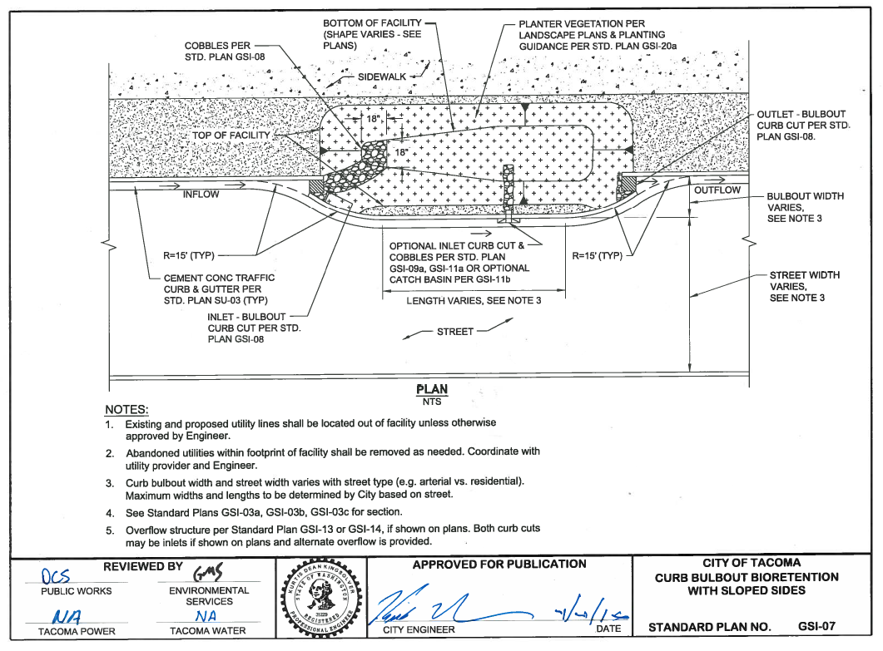

Slide 58
Inlet and Overflow Standard Plans
Many configurations available
Each appropriate for certain facilities/sites
Standard Plans for plan views and/or section views refer to these

Slide 59
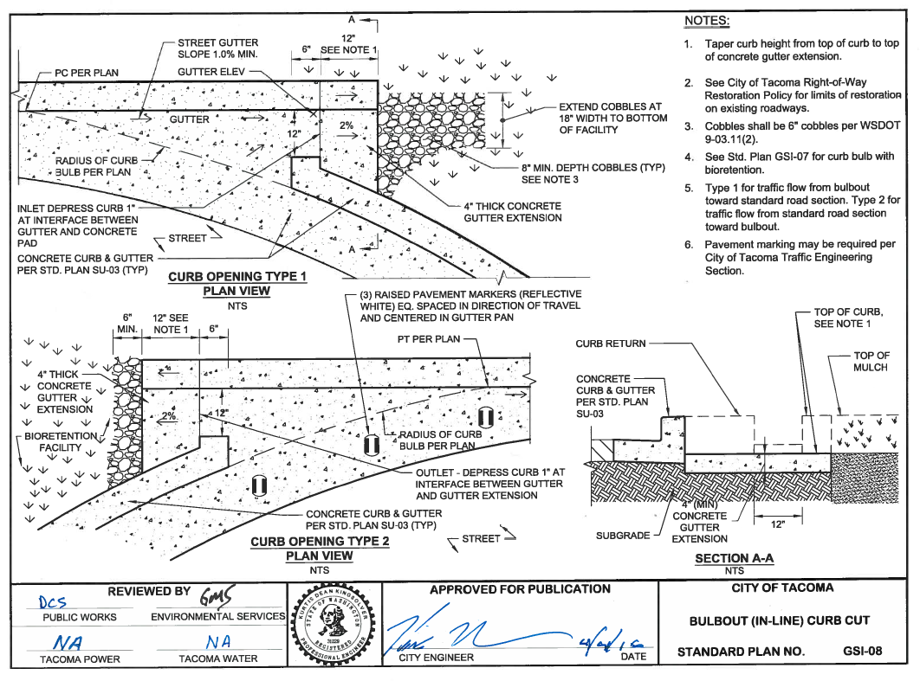

Slide 60
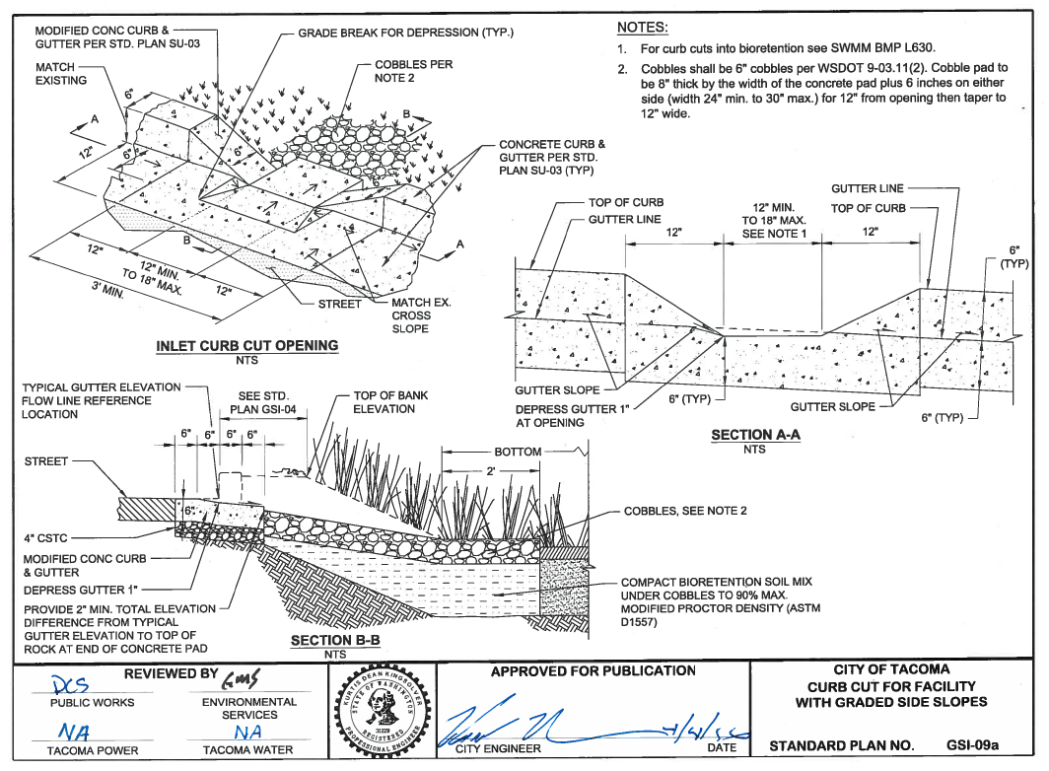

Slide 61
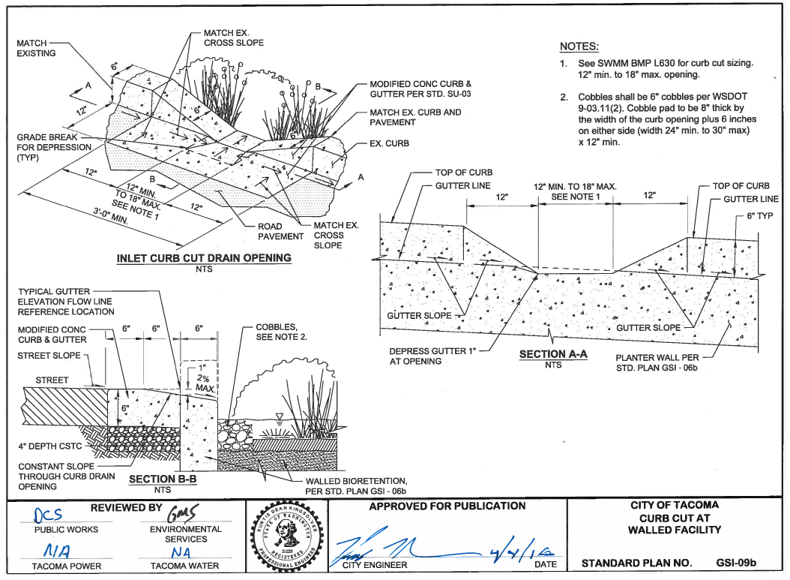

Slide 62
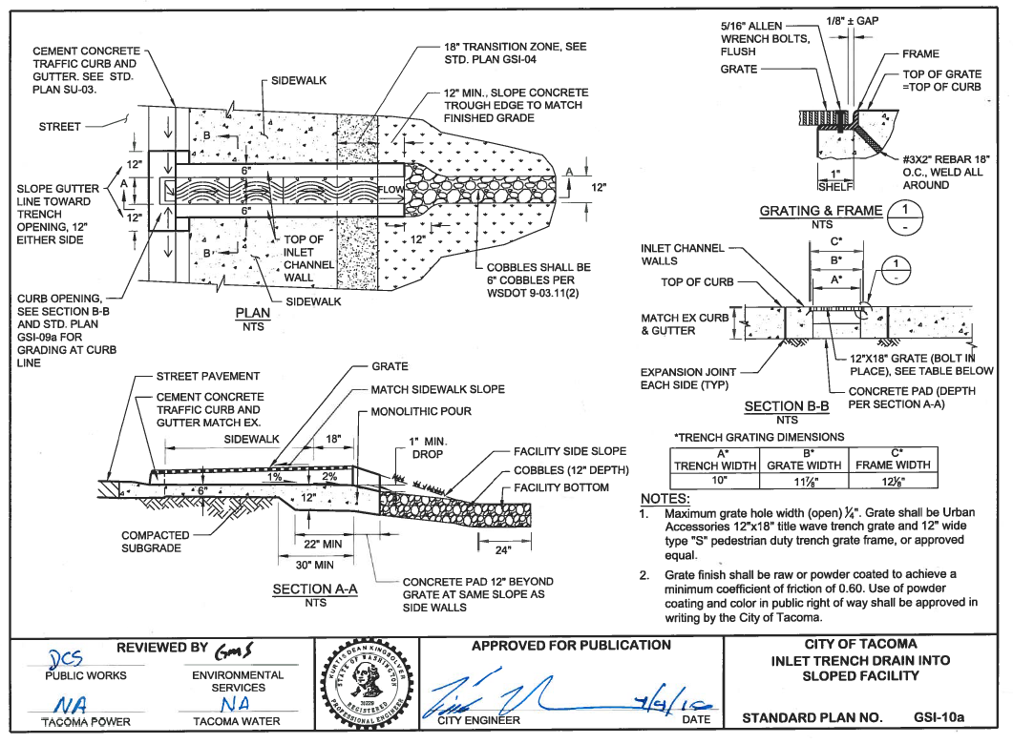

Slide 63
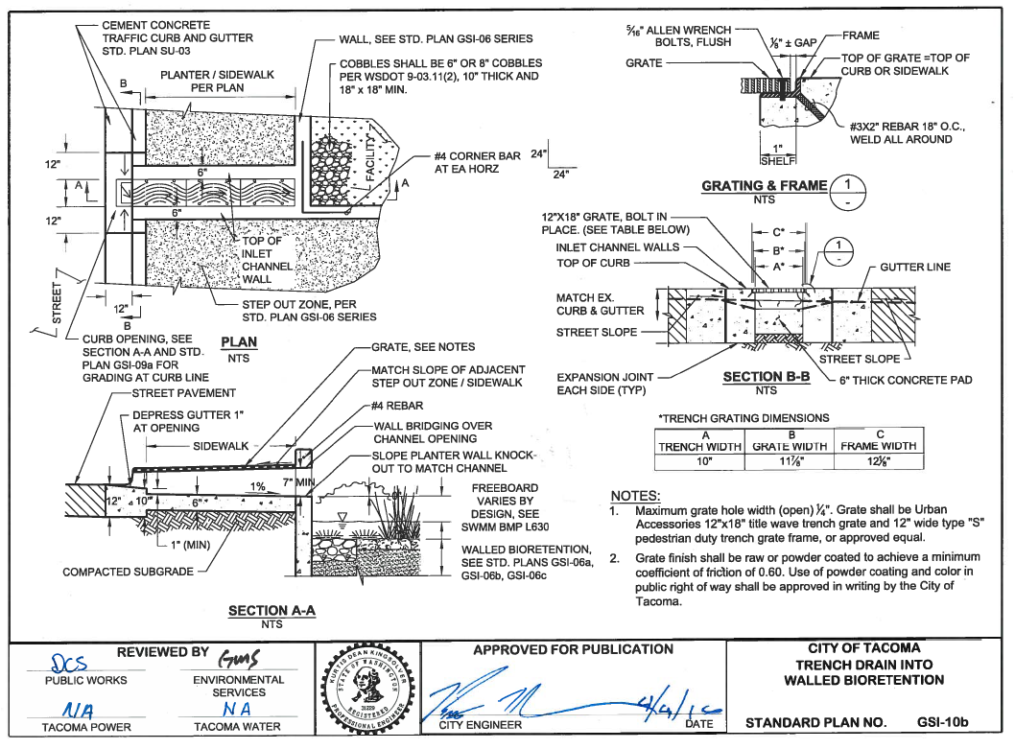

Slide 64
Inlets with debris collection
Used when needed for maintenance to allow easy removal of small amounts of debris
Various configurations depending on location and desired “look”
Not considered a pretreatment BMP per SWMM
Overflows / Outlets
Various configurations depending on location / facility
Overflows with a structure

Slide 65
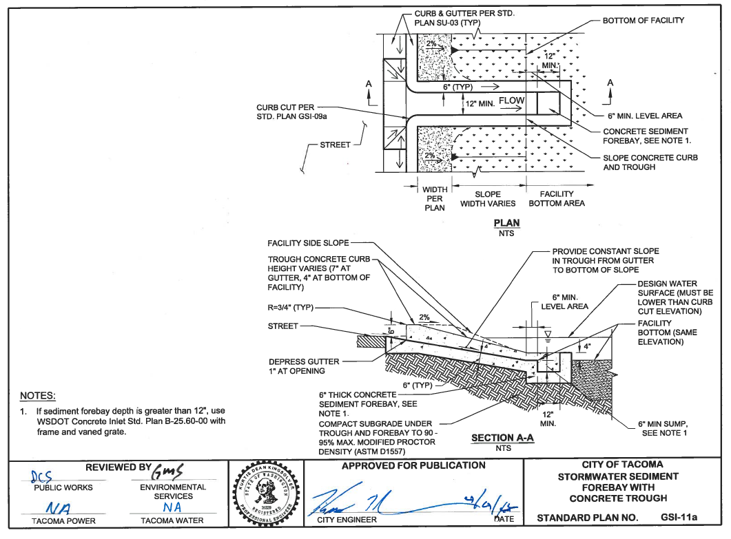

Slide 66
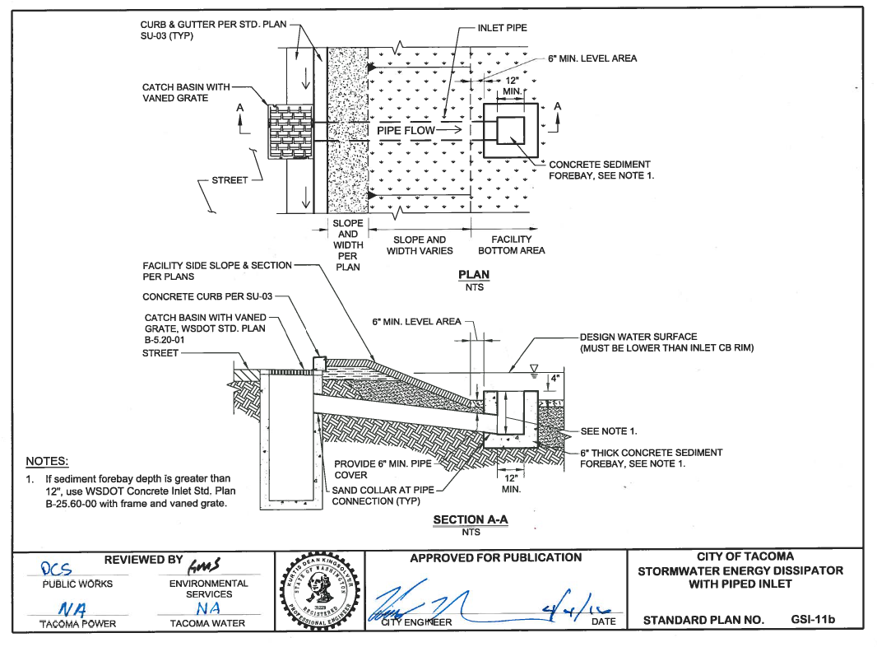

Slide 67
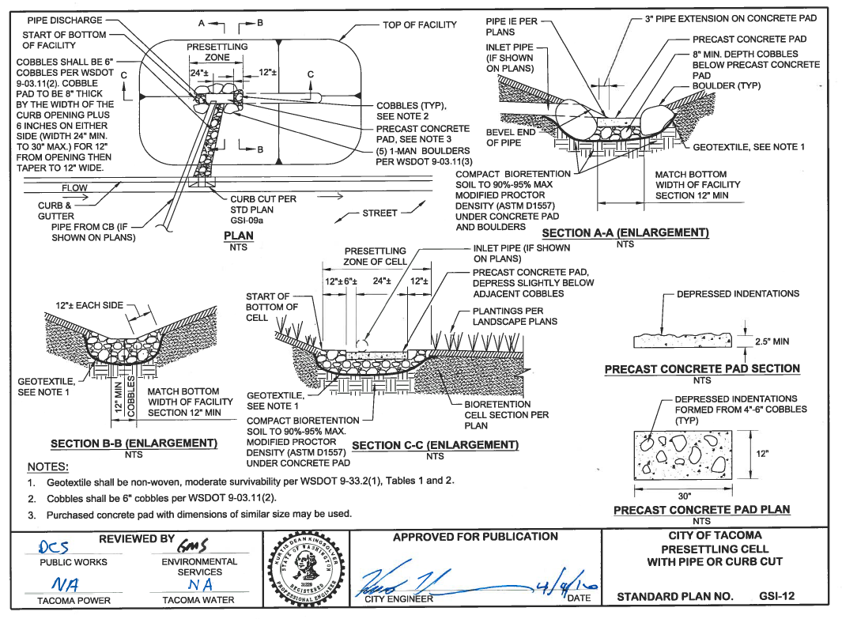

Slide 68
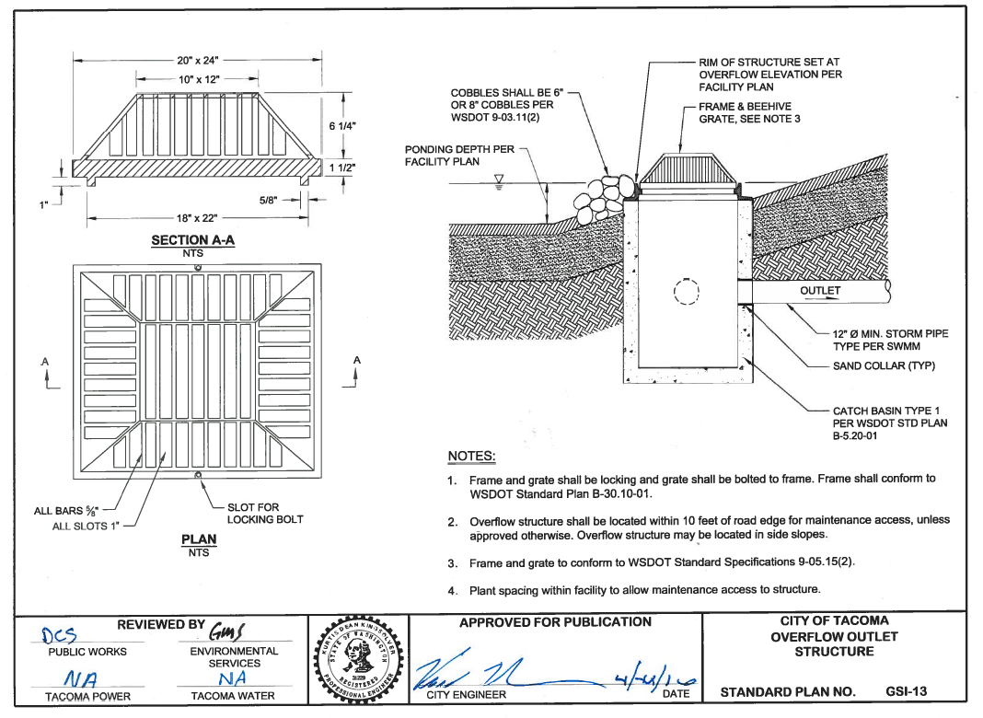

Slide 69
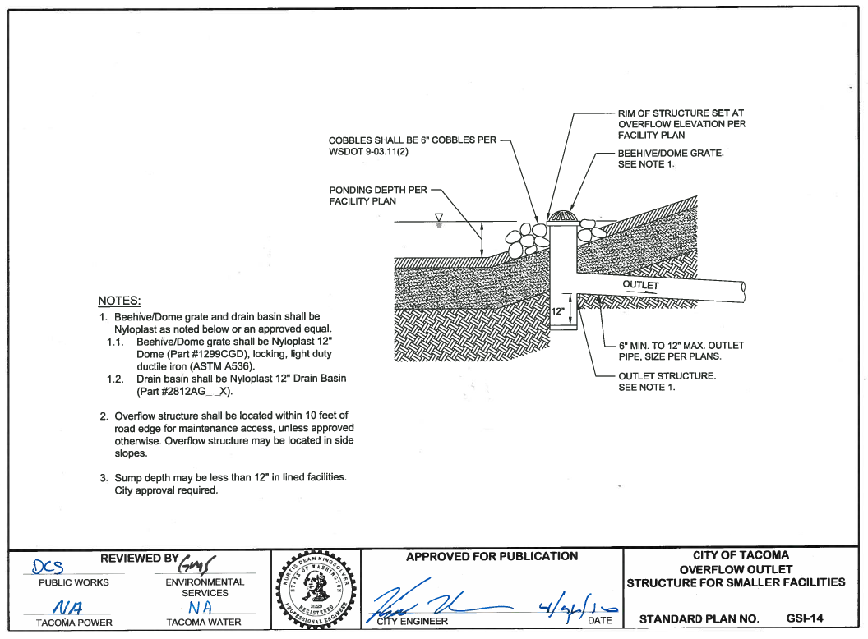

Slide 70
Overflows - When and where used
Unless designed for full infiltration, each facility needs an overflow.
May be used for emergency overflow for any facility
GSI Outlet Controls
Flow control outlet used for regulating flow – may be used to meet MR#7 or LID Performance Standard

Slide 71
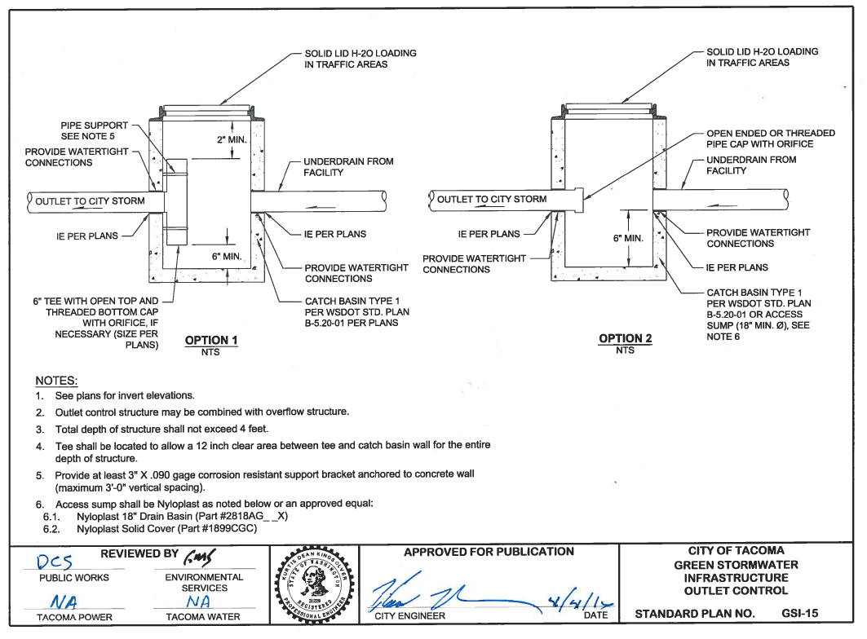

Slide 72
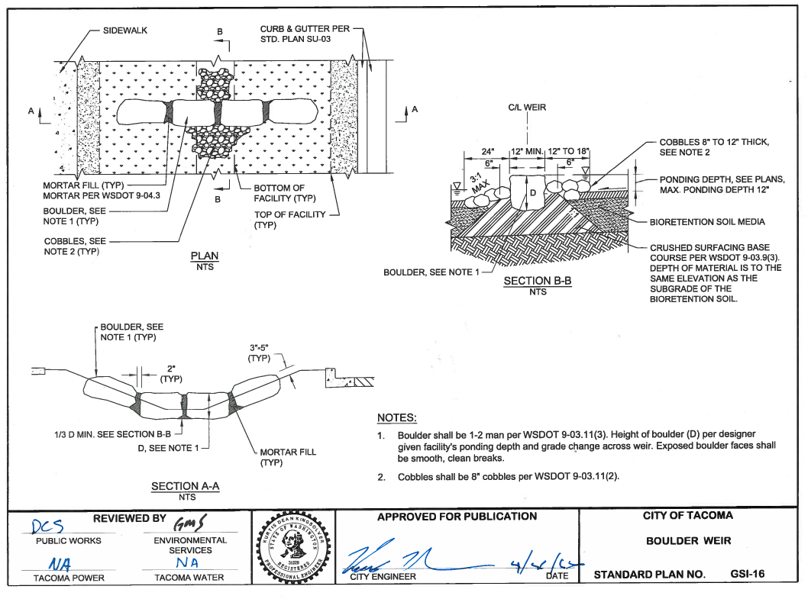

Slide 73
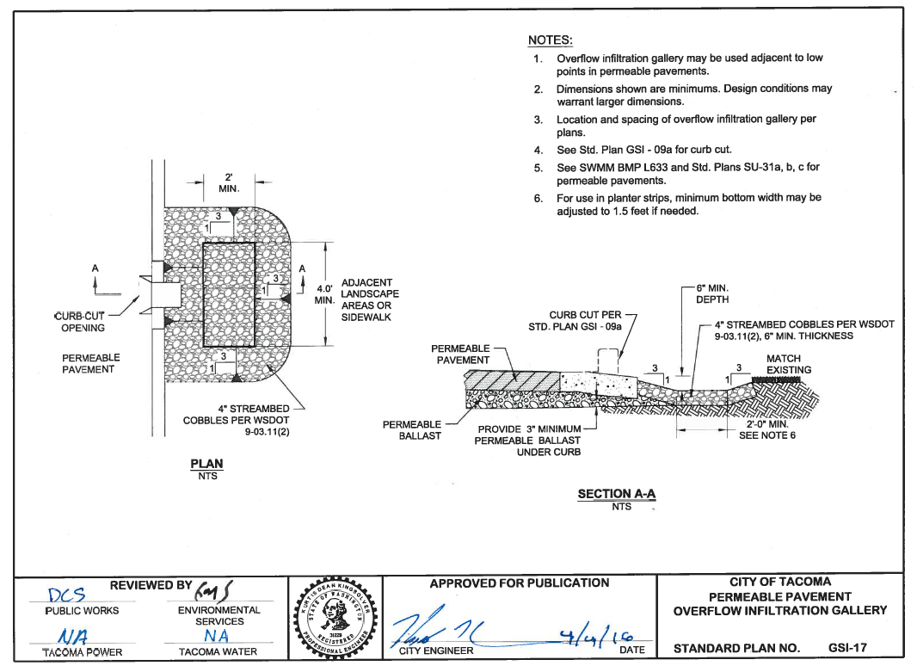

Slide 74
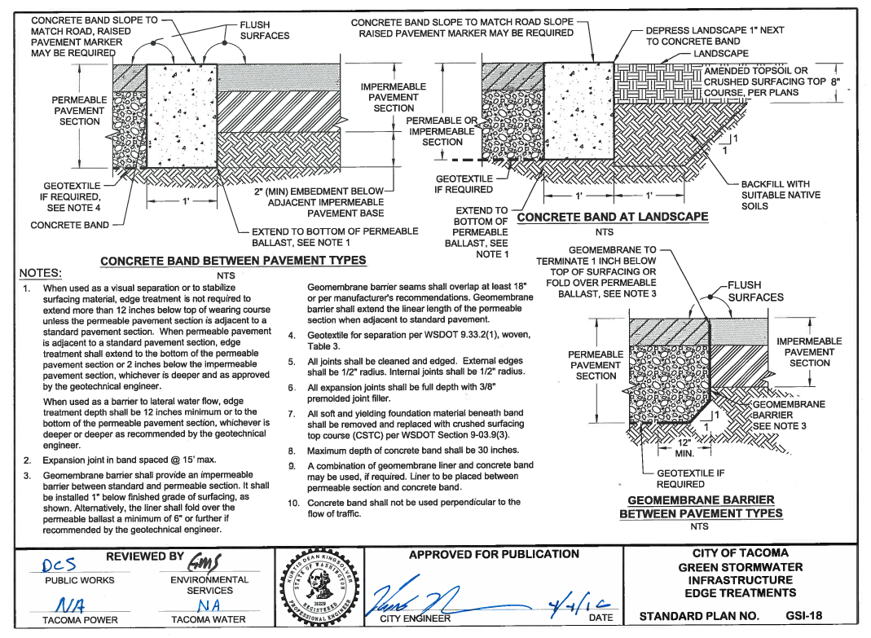

Slide 75
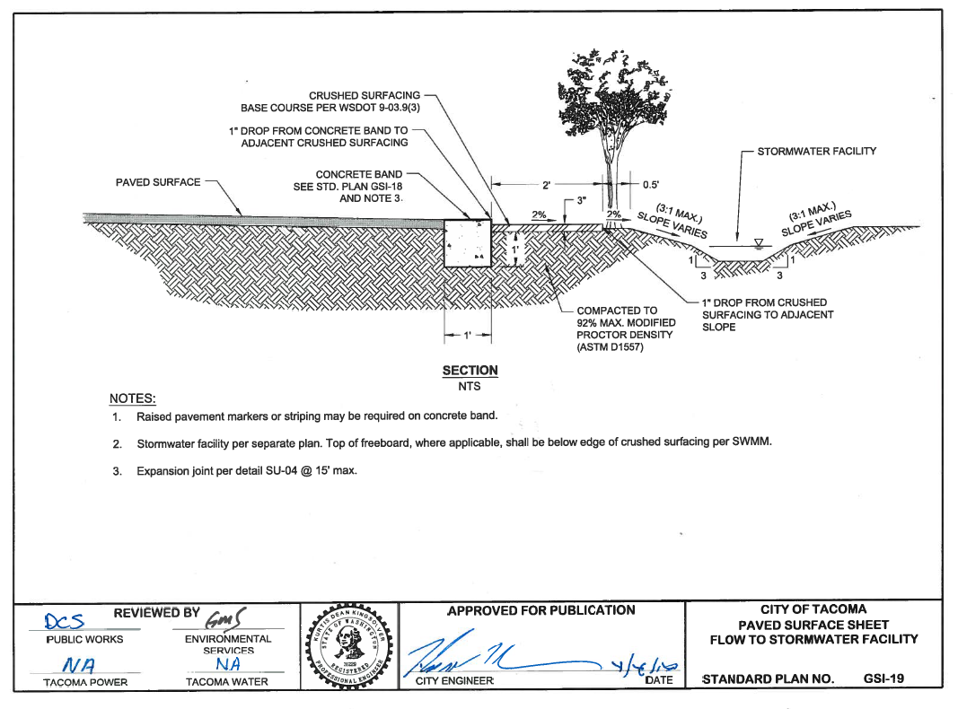

Slide 76
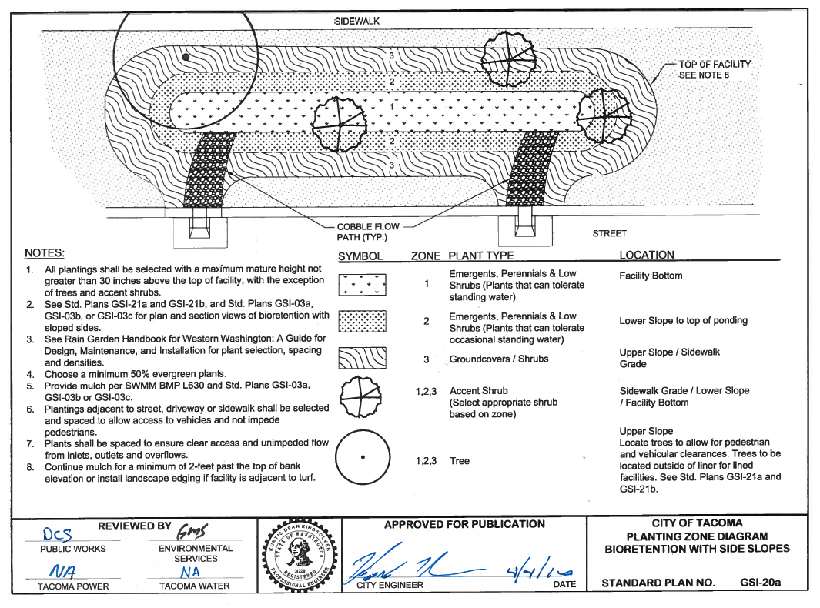

Slide 77
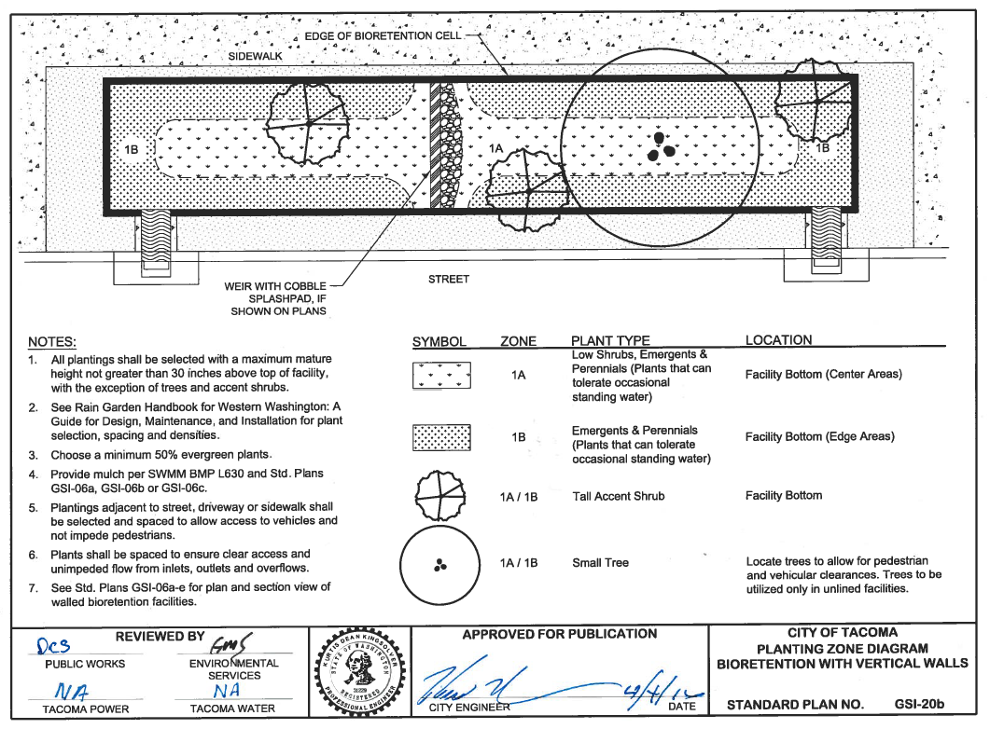

Slide 78
Planting Zone Diagrams
For use with bioretention facilities GSI -03 and GSI-06 series
Separate Planting Plan must be developed and submitted
Refer to Rain Garden Handbook for Western Washington: A Guide for Design, Maintenance, and Installation for plant selection, spacing and densities.
Within Right-of-Way, City of Tacoma may specify the plant palette and “look”
Certain installations may warrant a Landscape Architect
Certain installations may require design to an aesthetic standard instead of a functional standard

Slide 79
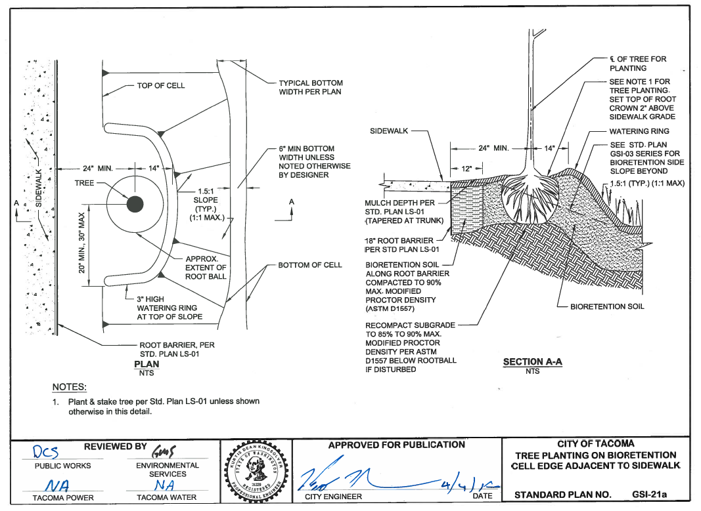

Slide 80
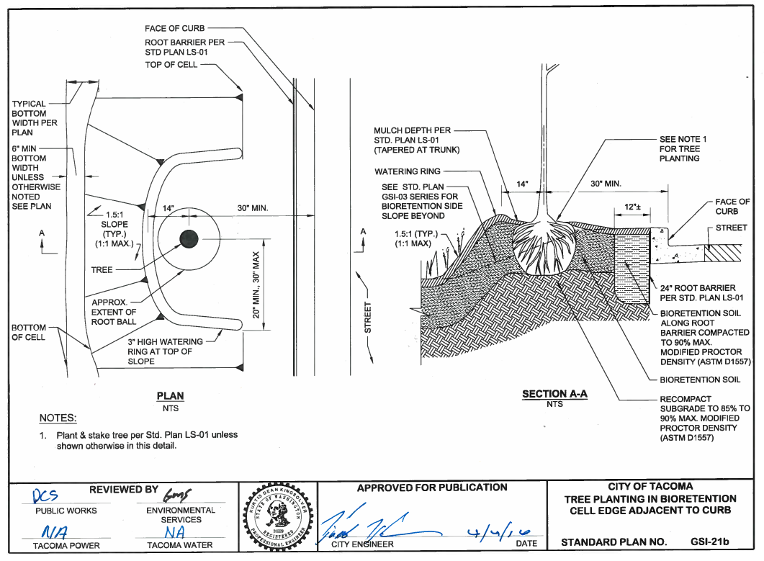

Slide 82
Cleanouts for Vegetated Stormwater Facilities
For use with LID and GSI vegetated facilities – may be modified for use in other facilities
Within Right-of-Way or City of Tacoma facilities, City of Tacoma may specify the type to be installed and location - contact Environmental Programs Group

Slide 87
SWMM Volume 6 BMP L631 Permeable Pavement
Soils Report Requirements per Volume 3 Appendix B
Additional soils /geotechnical info required to use infiltration for Minimum Requirement #6 Water Quality, See SWMM Volume 5 Section 7.6.4 – Permeable Pavement alone is not WQ appropriate underlying soils are necessary.
Refer to PD-01 and PD-02 as applicable
WWHM modeling required for reservoir layer sizing
South Tacoma Groundwater Protection may have additional permitting and water quality requirements, refer to SWMM Volume 5 Appendix D
Limit run-on and must account for it in calculations
See City of Tacoma Right-of-Way Design Manual Chapter 4 and APWA Standard Specification for Permeable Pavements and Soil Preparation http://www.wsdot.wa.gov/Partners/APWA/

Slide 91
SWMM Vol. 6 - BMP L631 Permeable Pavement
Ballasted Sidewalk guidance and requirements to be added to BMP L631 with upcoming errata
Soils Report Requirements per Volume 3 Appendix B
WWHM modeling is not required for typical sidewalk installations or single/family duplex driveways
Limit run-on. If run-on exists, it must be included in WWHM modeling calculations
See City of Tacoma Right-of-Way Design Manual Chapter 4 and APWA Standard Specification for Permeable Pavements and Soil Preparation http://www.wsdot.wa.gov/Partners/APWA/

Slide 99
SWMM Vol. 3 - BMP L605 Collect and Convey
An analysis of the downstream system may be required before connection to system see SWMM – MR#10
Storm Connection Permit Required
Contains notes for use with permeable sidewalk

Slide 103
SWMM Vol. 6 - BMP L631 Permeable Pavement
Soils Report Requirements per Volume 3 Appendix B
Additional soils /geotechnical info required to use infiltration for Minimum Requirement #6 Water Quality, See SWMM Volume 5 Section 7.6.4 – Permeable Pavement alone is not WQ appropriate underlying soils are necessary.
Refer to PD-01 and PD-02 as applicable
WWHM modeling required for reservoir layer sizing
South Tacoma Groundwater Protection may have additional permitting and water quality requirements, refer to SWMM Volume 5 Appendix D
Limit run-on and must account for it in calculations
See City of Tacoma Right-of-Way Design Manual Chapter 4 and APWA Standard Specification for Permeable Pavements and Soil Preparation http://www.wsdot.wa.gov/Partners/APWA/

Slide 106
Questions???

Slide 107
New details for Road
Channelization
Signage
Bus Stop
Road Markings
Barricades

Slide 118
Thank You for coming !
Contact info :
Merita Trohimovich 253-502-2103 mtrohimo@cityoftacoma.org
Mieke Hoppin 253-502-2105 mhoppin@cityoftacoma.org
Brennan Kidd 253-591-5077 bkidd@cityoftacoma.org
www.govme.com
www.cityoftacoma.org/designmanual
Dan Seabrands 253-591-5150 dseabran@cityoftacoma.org

